Slide 1



Studio Cancode
CANCODE
COMPANY
Presented by: EMİNE CANSU TÜRKKAN

Slide 2

INTRODUCTION
Introduce our anonymization strategies
Explain our adherence to ethical principles
Showcase our compliance with regulatory standards

Slide 3





ABOUT US
BUSINESS PROPOSAL
BUSINESS PLAN
"Our company offers cutting-edge solutions in data security and develops tailored data science projects to empower businesses with actionable insights while ensuring their data remains safe and compliant with the highest standards."
"We aim to position ourselves as a trusted partner in the tech industry by delivering secure and innovative software solutions, focusing on protecting sensitive information and enabling organizations to unlock the full potential of their data."

Slide 4





DATA ANONYMIZATION AND DATA ETHICS
Principles of Fairness, Privacy, Transparency, and Accountability
01
To introduce our data anonymization strategies and ethical principles.
02
To explain our approaches to ensuring regulatory compliance.
03
To demonstrate our commitment to ethical standards in data science.

Slide 5

WHAT IS DATA ANONYMIZATION?
What is Anonymization?
The process of removing or altering personally identifiable information (PII).
Goal: Keep data useful while protecting individuals’ identities.
Why is it Necessary?
Compliance with regulations such as GDPR and HIPAA.
Prevention of privacy breaches.

Slide 6


ANONYMIZATION TECHNIQUES
Techniques and Tools for Anonymization
Methods:
Generalization: Reducing details (e.g., Age → Age Group).
Randomization: Adding noise to data.
Data Segmentation: Creating small subgroups.
Models:
K-anonymity: At least K individuals share the same data attributes.
L-diversity and T-closeness models.
Tools:
Python libraries: ARX, Faker, Pandas.

Slide 7


TACKLING THE ISSUE
OF RE-IDENTIFICATION
How Do We Address Potential Re-Identification Risks?
Subtitles:
The Challenge:
The risk of re-identifying individuals in anonymized data.
Possibility of identification through external data linkage.
Solutions:
Differential Privacy: Adding noise to protect identifiable attributes.
Minimal Data Principle: Sharing only necessary data.
Access controls and monitoring.

Slide 8





FAIRNESS PRINCIPLE
Fairness: Preventing Biases
Why Fairness Matters:
Ensuring data and models produce equitable outcomes for all groups.
The impact of biases on company reputation and decision accuracy.
Customer Value
How We Ensure Fairness:
Inclusivity in data collection.
Comparing model performance across different groups.

Slide 9

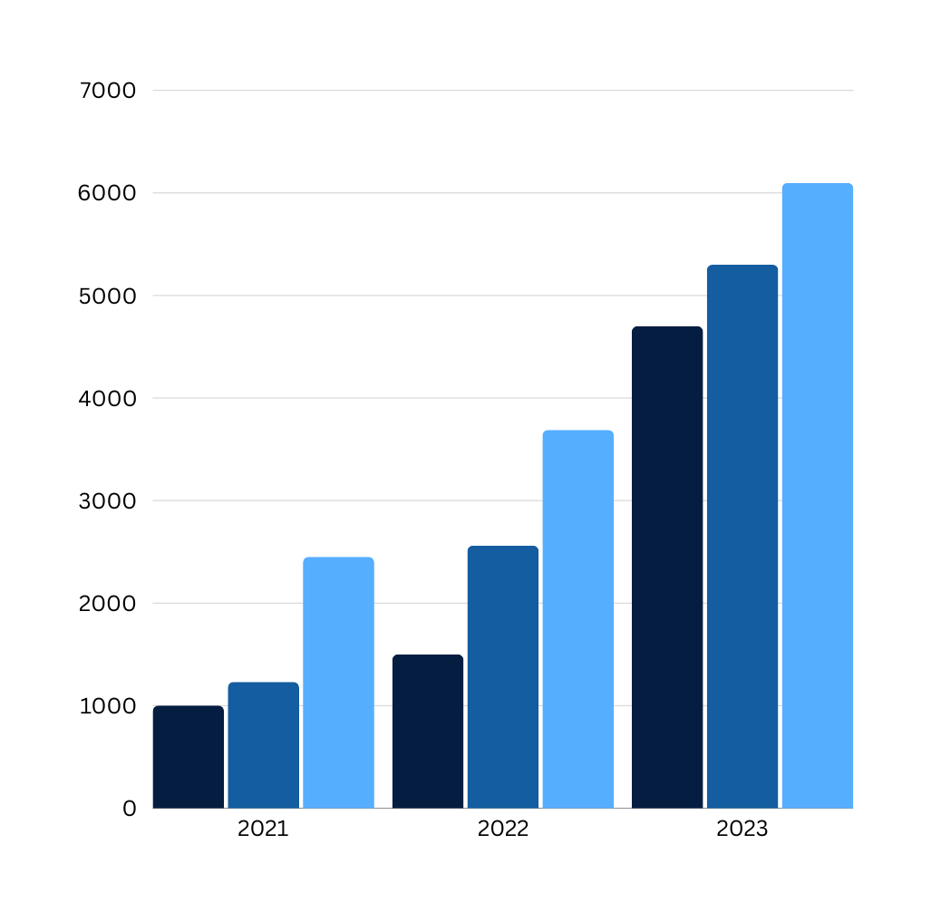
Privacy and Security Principle
Privacy and Security: Safeguarding Data
Privacy:
Data access policies and minimal data sharing.
Security:
Encryption and monitoring systems.
Application of Differential Privacy techniques.

Slide 10

TRANSPARENCY PRINCIPLE
Transparency: Data and Model Explainability
Transparency in Data Usage:
Informing customers about what data is collected and why.
Model Explainability:
Explaining the reasoning behind AI decisions.
Tools: SHAP, LIME for model analysis.

Slide 11
ACCOUNTABILITY PRINCIPLE
Accountability: Responsibility for Data and Models
Subtitles:
Handling Errors and Challenges:
Analyzing and correcting the impact of incorrect decisions.
Monitoring and Reporting:
Conducting periodic audits and providing reports to regulators.

Slide 12

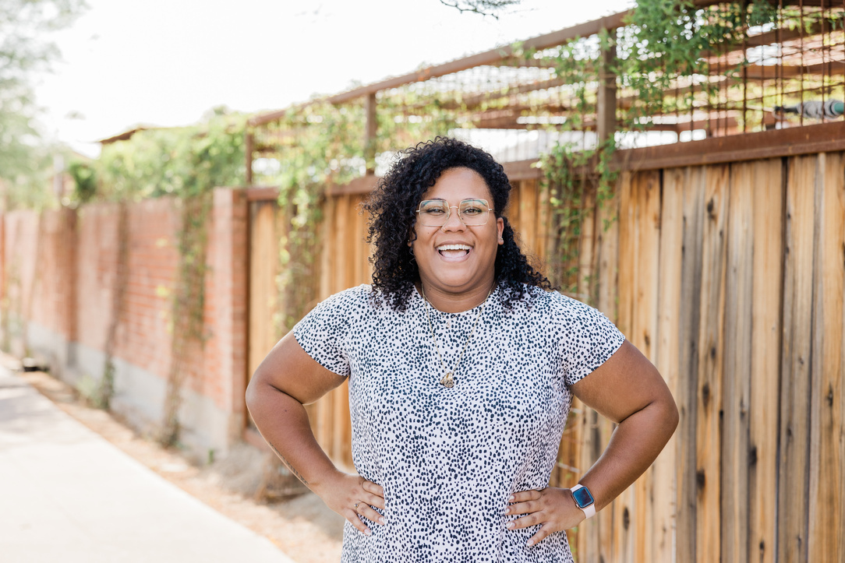


OUR TEAM
Olivia
Wilson
Emine Cansu Türkkan
Claudia Alves
Data Scientist
Manager
(Data Engineer)
Database Administrators

Slide 13


Studio Cancode
Thank's For Watching
Connect with us.
+123-456-7890
cansuturkkan@cancode.com.tr

Slide 14








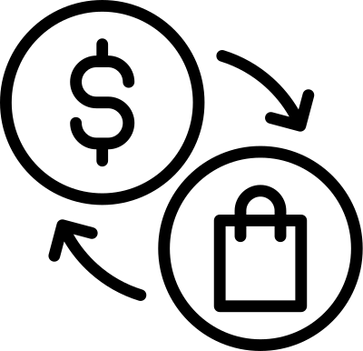




































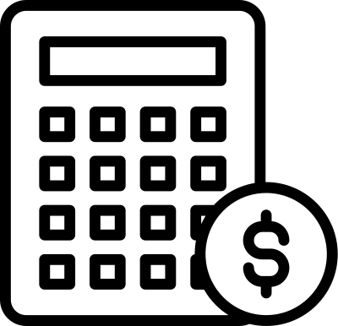


RESOURCE PAGE

